Slide 1

Is Washington Ready for EV Revolution?
By: Esha Patel, Jeff Morgan, Ipsita Pattanaik, Neil Lawren, Smita Shah

Slide 2
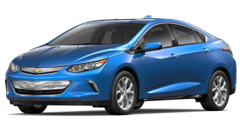
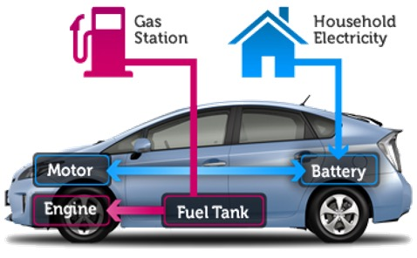
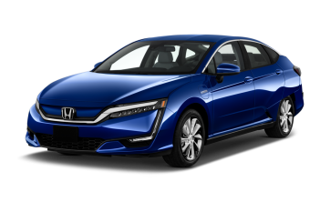
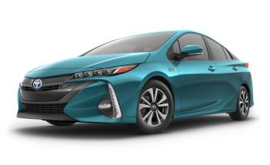
PHEV: Plug-in Hybrid Electric Vehicle
EREV
PHEV
Battery Charged using Electricity
Electricity accessed through Plug
PEV
How do they work?
Chevy Volt
Gas-fueled Internal Combustion Engine when Battery Depleted
Honda Clarity PHEV
Battery powers Electric Motor
Enough Battery for Short ALL-ELECTRIC Trips
Toyota Prius Prime

Slide 3
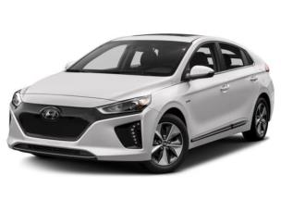
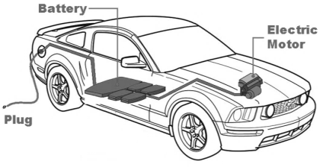
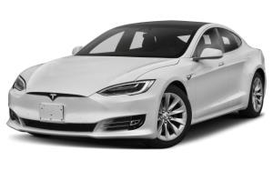
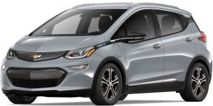
BEV: Battery Electric Vehicles
BEV
How do they work?
PEV
Battery charged using Electricity
Nissan
Electricity accessed through Plug
Tesla
Battery powers Electric Motor
Chevy

Slide 4
Data Sources Used
https://rapidapi.com/letscrape-6bRBa3QguO5/api/ev-charge-finder
- Charging Location
https://fueleconomy.gov/feg/tax2023.shtml
- Tax Incentives 2023
https://catalog.data.gov/dataset/electric-vehicle-population-data
- Washington State Data

Slide 5

3 Sub-Questions Asked
QUESTION 2
What is the ratio of cars to chargers in the selected cities?
What is the availability of fast and slow charging ports per city?
QUESTION 3
What are the most popular car models in the selected cities, and do they have federal incentive?
QUESTION 1
Which cities in Washington have the most electric and hybrid cars registered?

Slide 6
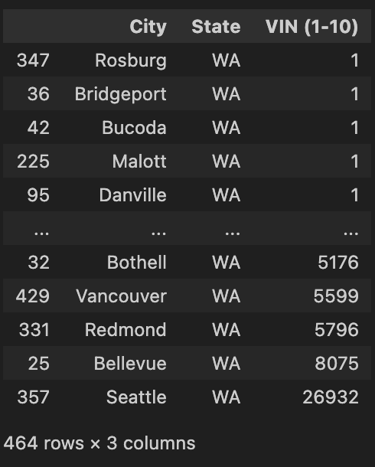
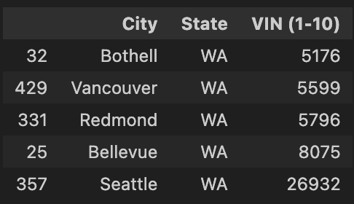
Question 1: Which cities in Washington have the most electric and hybrid cars registered?
Notes:
We have total 159106 rows of data for Washington State.
We did group by city and state and counted the VIN(1-10) which provided us with 464 rows with total count of All-Electric Vehicles and Plug-in-hybrid vehicles.
We wanted to compare top 5 cities with the most data on EVs so we got the following cities: Bothell, Vancouver Redmond, Bellevue, Seattle

Slide 7
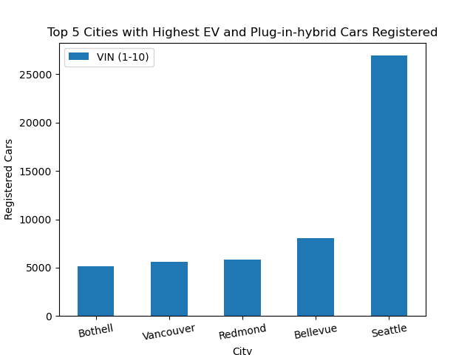
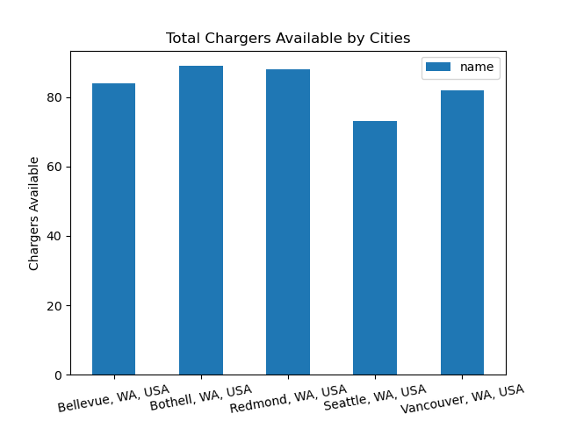
The graph below shows total chargers available for each of our top 5 cities.
The graph above shows our top 5 cities and the total registered cars per city.

Slide 8
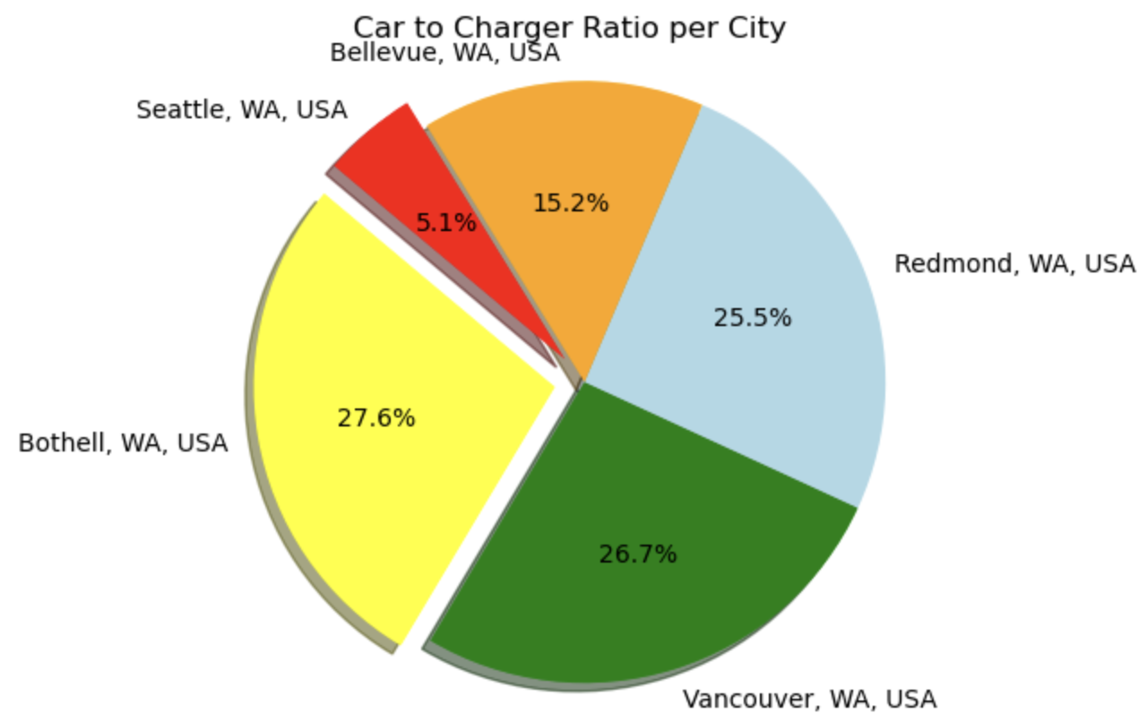
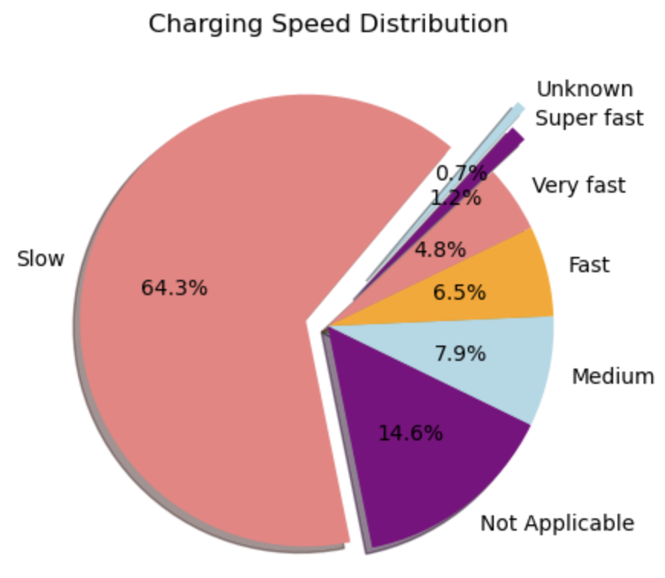
Question 2: What is the ratio of cars to chargers in the selected cities? What is the availability of fast and slow charging ports per city?

Slide 9
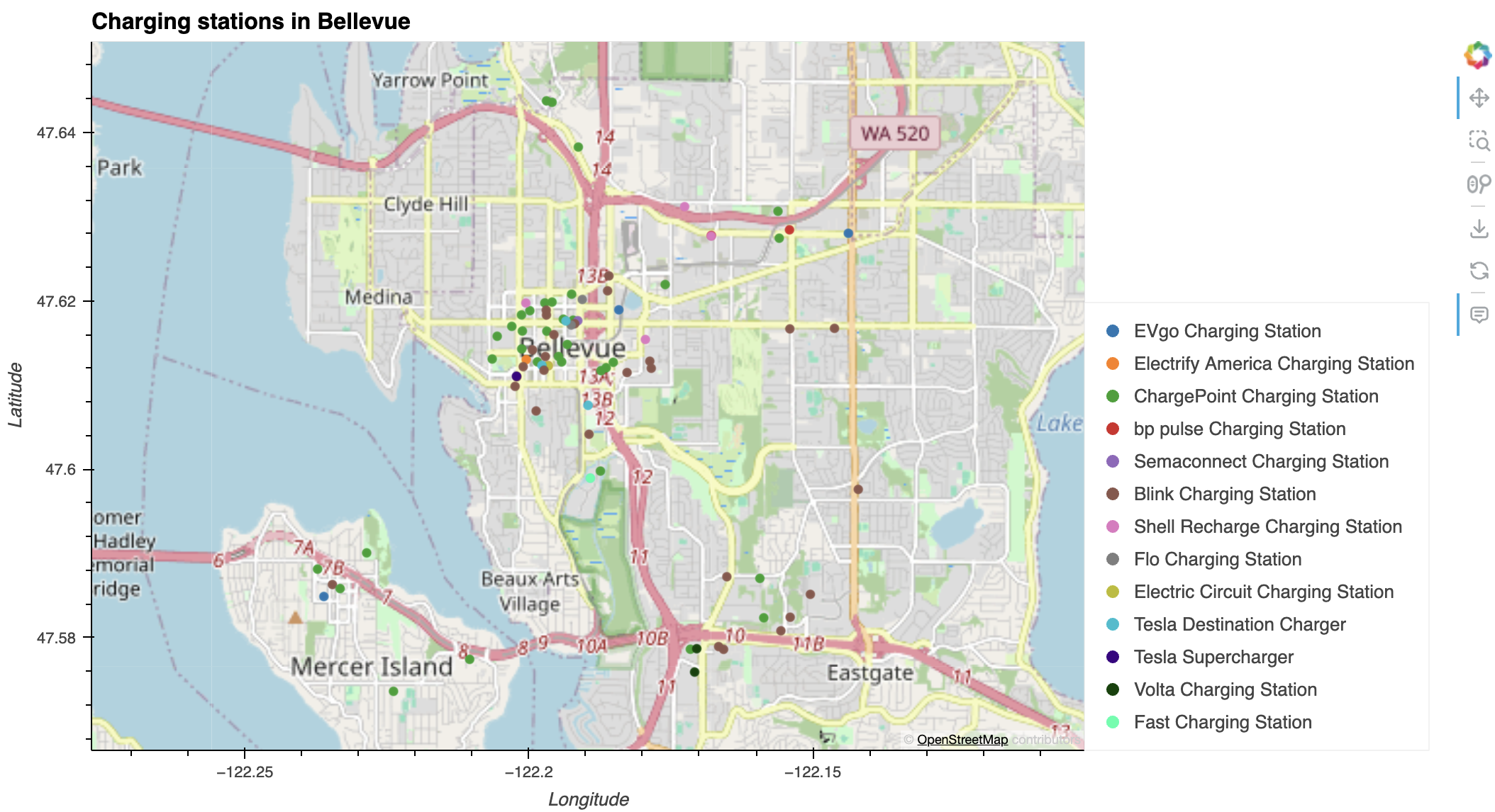
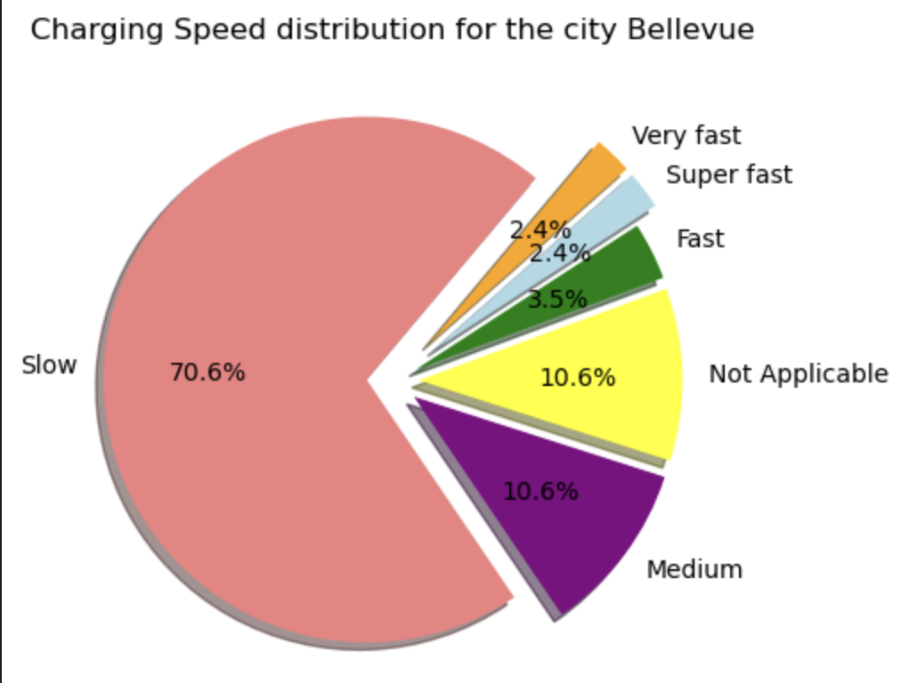
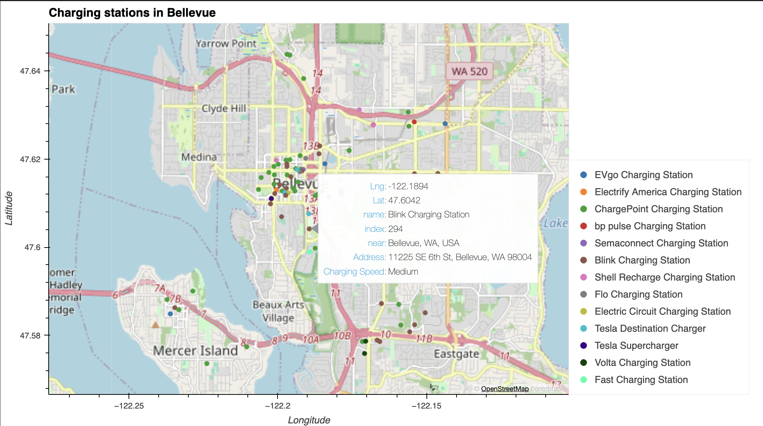
Charging Stations near Bellevue, WA

Slide 10
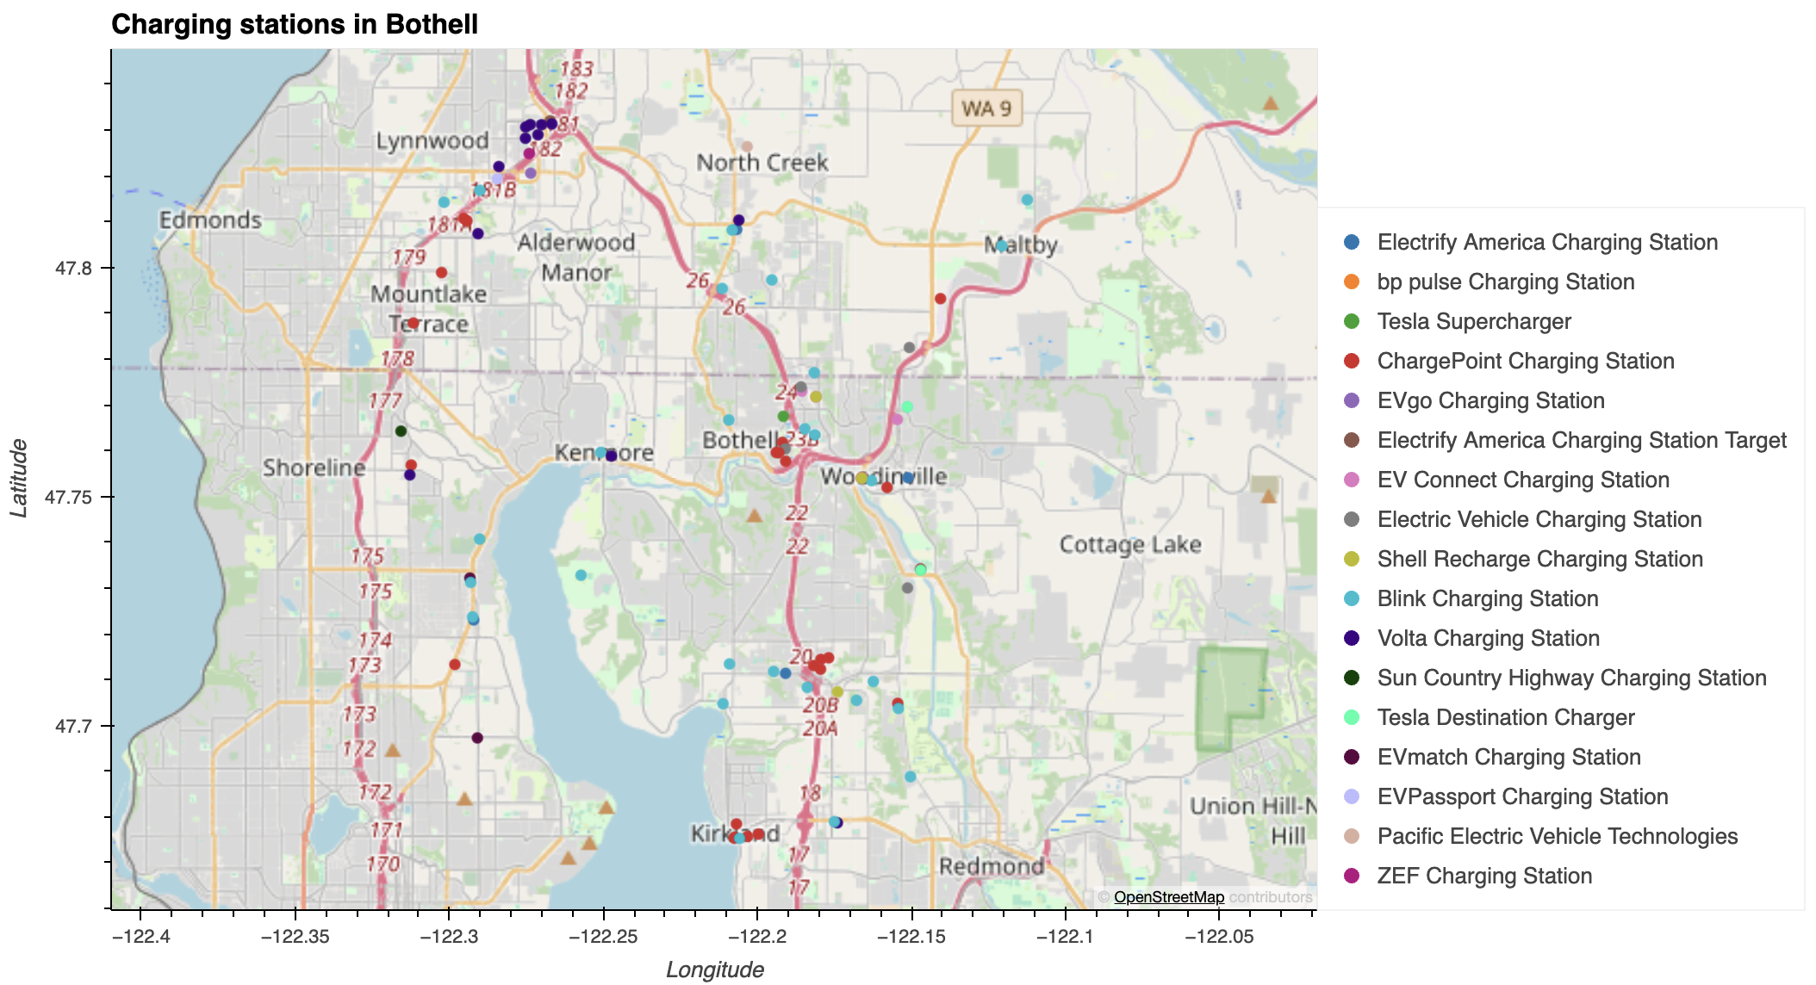
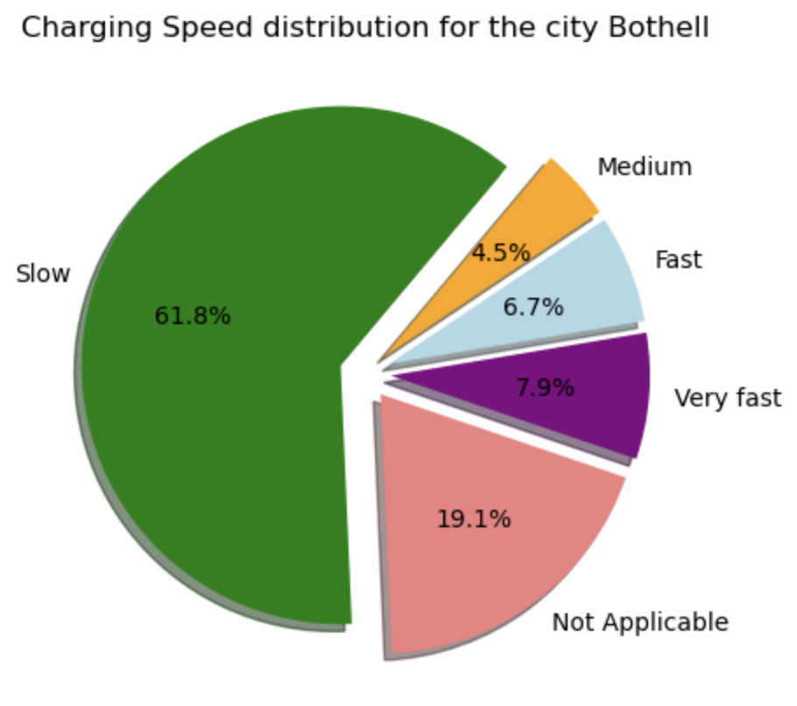
Charging Stations near Bothell, WA

Slide 11
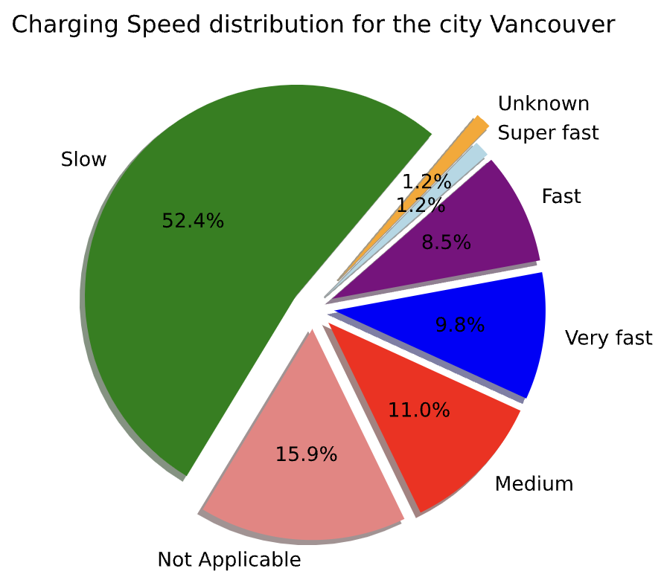
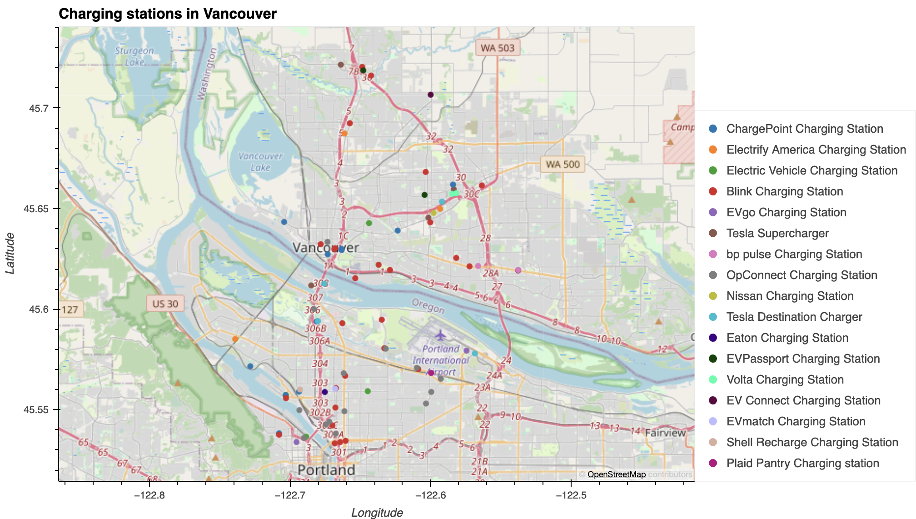
Charging Stations near Vancouver, WA

Slide 12
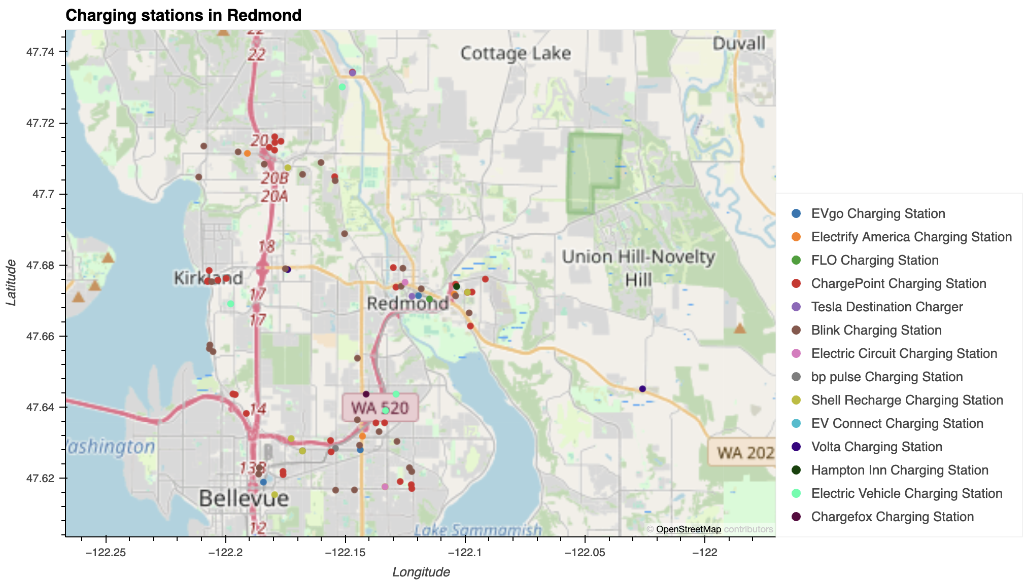
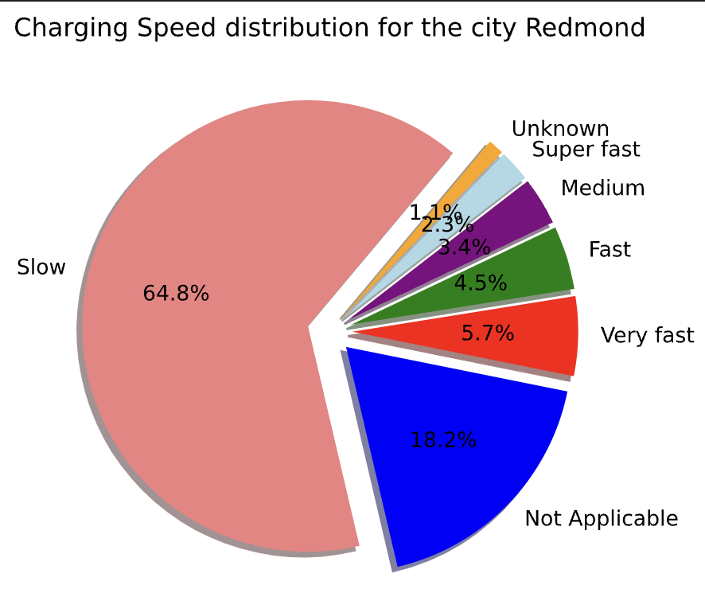
Charging Stations near Redmond, WA

Slide 13
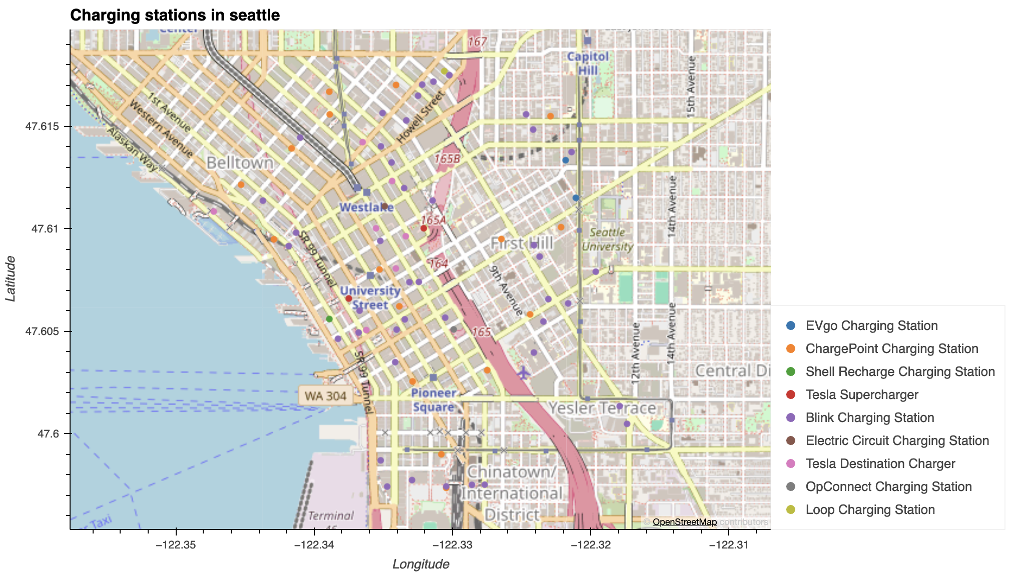
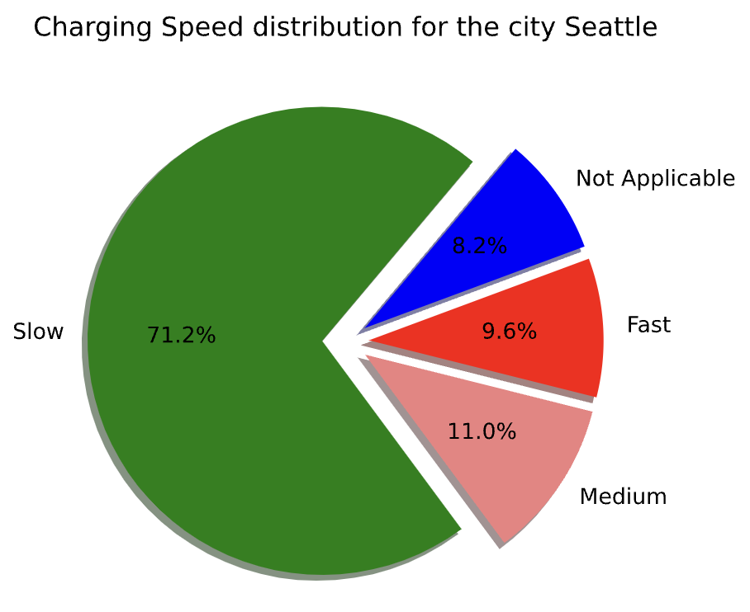
Charging Stations near Seattle, WA

Slide 14
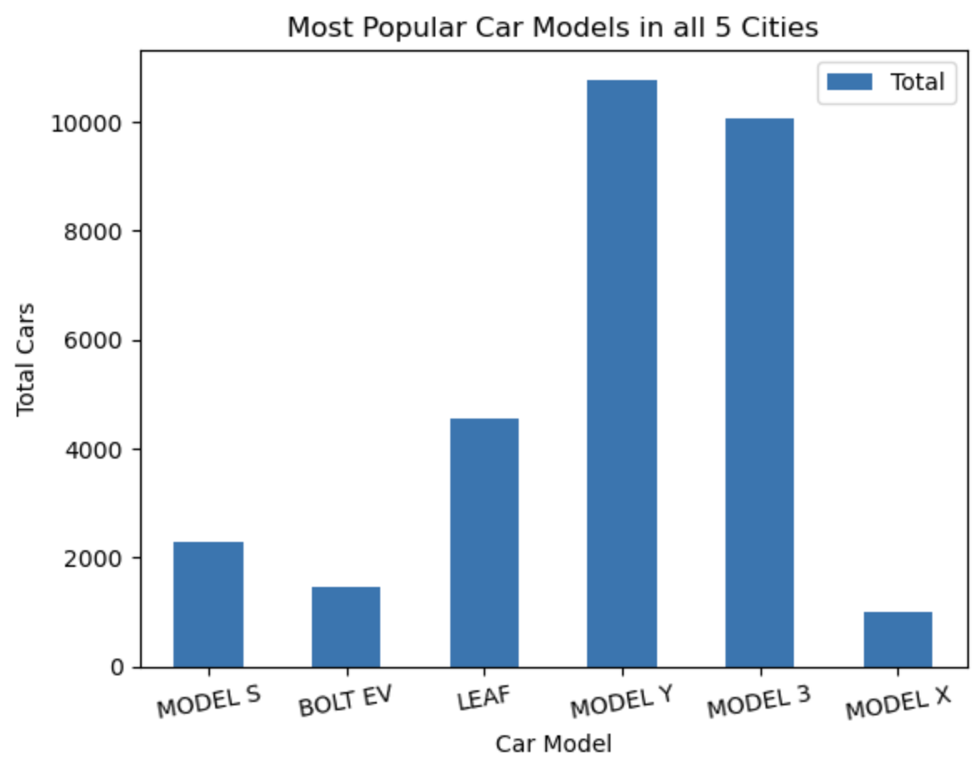
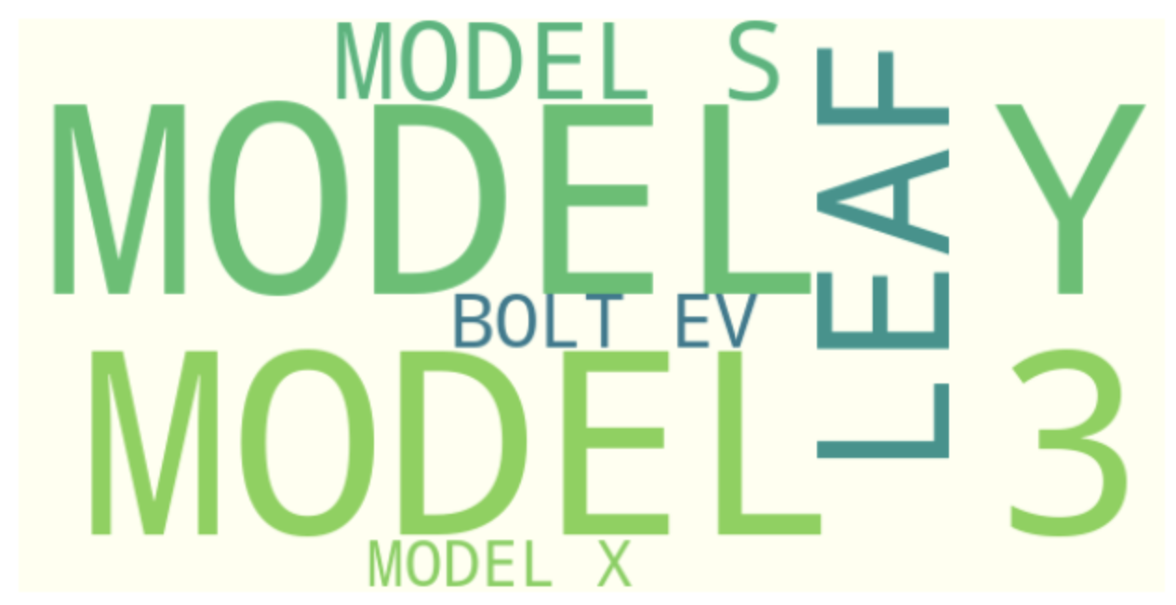
Question 3: What are the most popular car models in the selected cities, and do they have federal incentive?
Notes:
ESHA SPEAKS

Slide 15
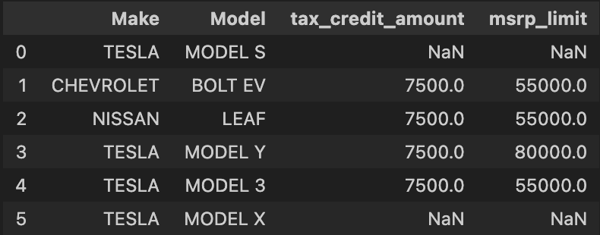
4 out of the 6 most popular car models qualify for federal incentives !!
Notes:
ESHA SPEAKS

Slide 16
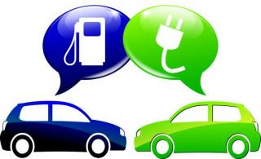
Potential benefits of buying EVs
Grants, Rebates and Tax Credits for new or used EVs & chargers
Electricity Rates more stable than gasoline prices
Maintenance Costs are lower, especially with long battery warranties
Free or Reduced Tolls
Cheaper to Charge than to
fill the tank
Notes:
SPEAK ESHA

Slide 17
Is Washington Ready for EV Revolution?
No !!!
Notes:
Based on our research and provided the data, we do not think Washington State is ready for the EV Revolution yet. In our project, we have analyzed the top 5 cities with the most electric vehicles registered and we found that there are many charging stations available. High-speed charging can adversely impact the lifespan of a car's battery. Nonetheless, the majority of cars are equipped with an integrated battery management system designed to regulate both the charging speed and the temperature of the battery. Most of the charging stations are slow in charging speed which would not be convenient for everyone specially those who do not have charging stations near their homes and workplaces which will result in issues like cars not having sufficient charge when needed.
When purchasing an EV vehicle, it is important to know if there are any federal and state incentives provided.

Slide 18
Limitations
Due to the limitation of time and funds, it restricted the depth and thoroughness of the analysis that can be performed. Most of the data available required a lot of funding which we did not have to complete the project.
Another challenge was data acquisition. We were unable to find datasets for free. There are chances that our free datasets may be incomplete or outdated, affecting the accuracy of the analysis.

Slide 19
QUESTIONS

